Slide 1
Power platform Overview
Notes:
This module introduces students to the PowerApps Service and the fundamentals of creating and testing web and mobile applications using PowerApps Studio. Students will learn to create and configure an isolated development environment for building custom solutions with PowerApps and Microsoft Flow. The module teaches students how to create a modern user interface experience in PowerApps Studio by working with screens and controls and by writing dynamic PowerApps formulas for control properties. The module introduces student to connectors and explains how connectors are used in PowerApps to connect an app to an external data source. The module teaches students how data binding works in PowerApps and demonstrates how to use data binding with gallery controls, form controls and data cards.

Slide 2
Agenda
Introduction to the Power platform
Power BI
PowerApps
Flow
Power platform Integration
Building a Trial Environment

Slide 3
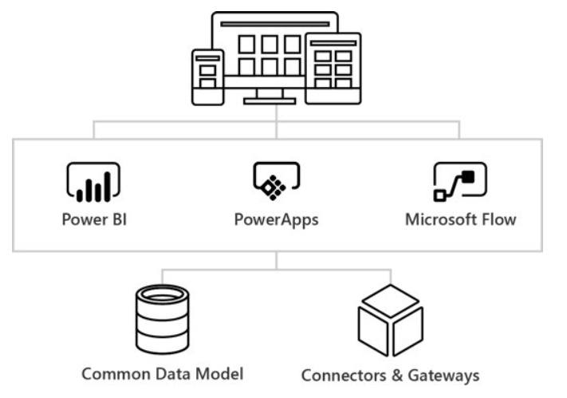
What is the Power platform?
Notes:
PowerApps and Microsoft Flow are to important pieces of the Microsoft initiative known as the Business Application Platform. Together with Power BI, PowerApps and Flow make up the “Power Trio” of the Business Application Platform
The Business Application Platform has been specifically designed for business users and technical specialists who do not have the background of a software developer. The ultimate goal of the Business Application Platform is to allow business users and technical specialists within an organization to build custom applications and workflow solutions in a fraction of the time compared to the traditional lifecycle of a software development project. The Business Application Platform has also been designed with a mobile-first philosophy which makes it relatively easy and very effective to build applications that target mobile devices such as iPhones and Android phones.
The Business Application Platform consist of these services
PowerApps is a service for building and consuming web applications and mobile apps that connect to data
Microsoft Flow is a service for automating workflow across the growing number of apps and SaaS services
Power BI is a business analytics service which provides self-service BI and great interactive visualizations
The Common Data Service for Apps provides the native storage of business data in the PowerApps environment
Connectors and Gateways provide the Business Application Platform with access to external data

Slide 4
No code / Low Code
Citizen developers
No
Less costly than
Professional development for web and mobile
Multidimensional development with SSAS
Can be extended
Power BI Embedding
Custom Visuals for Power BI
Custom Controls with PowerApps
Custom Connectors to Power BI, PowerApps and Flow

Slide 5
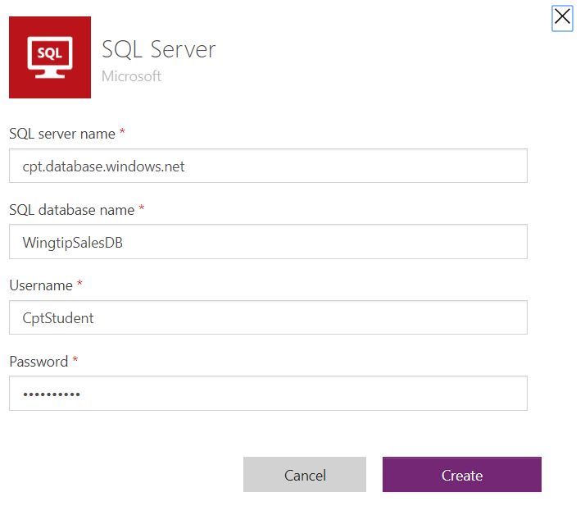
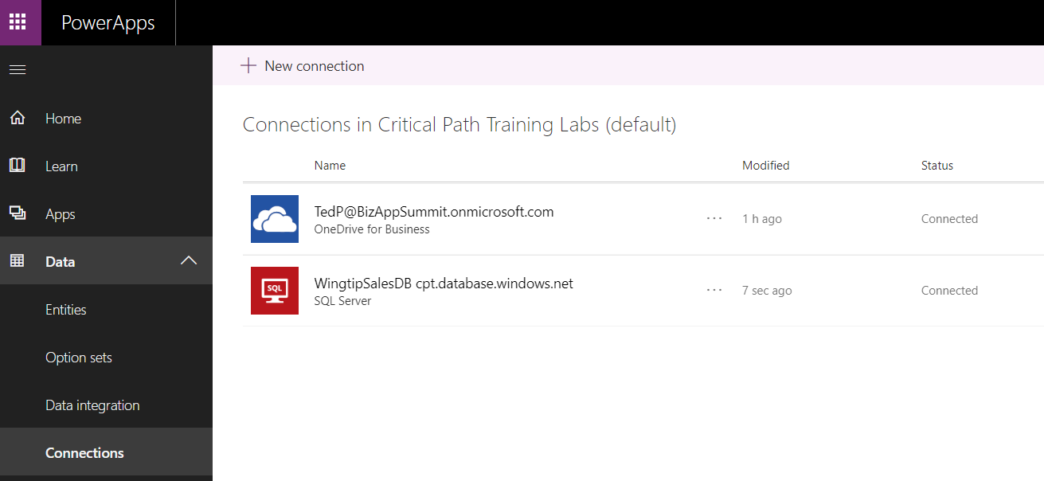
Connecting to Data
What is a Connector?
API wrapper that PowerApps uses to interact with datasource
What is a Connection?
Configuration created to connect to a specific datasource
Each connection is created using a specific connector
Connection also caches login credentials and granted permissions
Connections can be shared across users
Notes:
One of the strengths of PowerApps is that it makes it relatively easy to build an app that connects to data. Keep in mind that the data you need to access may be stored in many different types of datasources. You bring that data into your app by creating connections. Each connection is created by a specific user and may be shared across users. If you navigate to the PowerApps home page, you can see your current set of connections by navigating to Data > Connections node in the left navigation menu as shown in the screenshot in the slide above.
To become proficient at building apps with PowerApps, you must learn the key concepts involved with connectors. A connector is a wrapper around an API that PowerApps uses to interact with a specific type of datasource. Each connection you create is based on a specific connector which knows how to communicate with the datasource to which you are connecting. PowerApps provides out-of-the-box connectors for many popular services and on-premises datasources including SQL Server, SharePoint, OneDrive for Business, Azure AD, Dynamics 365, Salesforce and Twitter.
There are two important aspects of connectors and connections that relate to security. When using a connection for the first time, the user is often prompted to provide security credentials such as a user name and password to establish a secure connection to the datasource. After the user supplies security credentials the first time, the connection is able to cache those credentials and reuse them to reestablish connections to that datasource in the future without any need for user interaction.
The second security-related aspect of connections has to do with users delegating permissions to an app. A connection often allows an app to read and write to a datasource on behalf of the current user. PowerApps prompts users with an interactive dialog which allows a user to grant permissions to a connection which is required in order to read and write to a datasource on a user’s behalf.

Slide 6
On-premises Data and Gateways

Slide 7

What is a Power BI Gateway?
Gateway connects Power BI to data source
Runs on PC or server joined to domain
Extracts data and returns it to Power BI service
Private Network with Active Directory Domain
Power BI Service
On-prem SQL Server
SQL Database
Power BI Workspace
PC or Server
Azure Service Bus
Power BI
Report
extract
Power BI
Gateway
request
SharePoint On-Prem
refresh
Power BI
Dataset
SharePoint List
Excel Workbook

Slide 8
Common Data Service for Apps

Slide 9
Mobile

Slide 10
Secure
Security just works
User authentication just works - no development

Slide 11
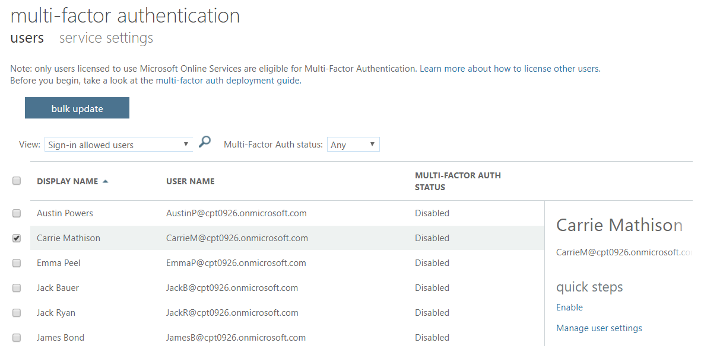
Multifactor Authentication
Enabled through admin portal
Requires Office 365 or Azure AD Premium

Slide 12
Enterprise Ready
Integrated in Azure AD
PowerShell ALM

Slide 13
Agenda
Introduction to the Power platform
Power BI
PowerApps
Flow
Power platform Integration
Building a Trial Environment

Slide 14
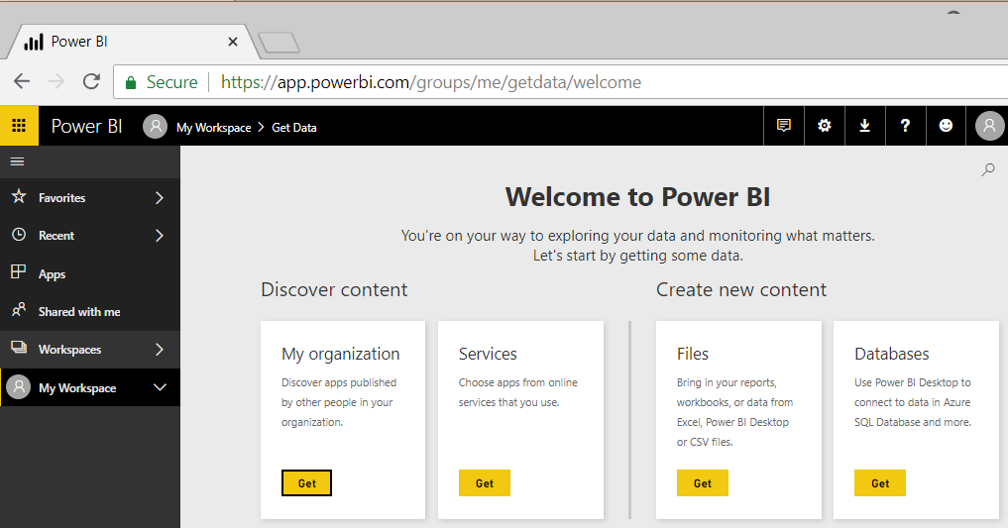
Accessing the Power BI Portal
Power BI portal is accessible using a browser
Access provided through base URL of https://app.powerbi.com
Power BI portal supports all modern browsers
Every licensed user gets their own personal workspace
Notes:
The easiest way to access Power BI is by connecting to the Power BI Service with a browser at https://app.powerbi.com.
The Power BI Service support all modern browser and is also accessible on mobile devices by installing the Power BI app published by Microsoft.
Any user accessing the Power BI Service in the browser requires a Power BI license which can be either a Power BI Pro license or a Power BI free license. Every user with a Power BI licenses gets a personal workspace which provides a place to begin creating datasets, reports and dashboards.

Slide 15
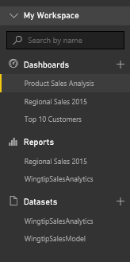
Central Power BI Concepts
Workspace
Provides user context and asset container
Every user has personal workspace
Team development requires group workspaces
Dashboard
Consolidated view into reports and datasets
Custom solution entry point for mobile users
Report
Collection of pages with tables & visualizations
Provides interactive control of filtering
Dataset
Data model containing one or more tables
Can be very simple or very complex
Notes:
You can think of a workspace as a container that holds three different kinds of assets; dashboards, reports and datasets. Every dashboard, report and dataset created in Power BI must be created within the scope of a specific workspace. A workspace also provides a user context because the current workspace always determines which set of dashboards, reports and datasets are visible to the user.
Every Power BI subscriber has a personal workspace which is named My Workspace. An organization can also create app workspaces which make it possible to achieve team-based authoring and staged deployment of custom solutions. The course will go into greater detail on working with app workspaces later in module 7 when discussing how to deploy reports and dashboards.
A dashboard typically serves as the top-level entry point into a custom data analytics solution. In Power BI, a dashboard is created as a consolidated view on top of reports and datasets. Dashboard are also important to Power BI mobile users because there display is often optimized for mobiles devices such as iPhones, Android phones and Windows 10 phone.
A report is a collection of pages that is associated with exactly one underlying dataset. Each page in a report serves as a canvas on which you can add tables, matrices and other types of visualizations. While dashboards are designed to provide a high-level overview, reports are the opposite because they are used to drill down into the lower-level details. Reports also provide much more interactive filtering control for custom solutions in which the user must be given the ability to drill down into further levels of detail.
A dataset is a collection of one of more tables that defines a data model. A simple dataset can contain a single table with three columns and ten rows. However, a dataset often contains multiple tables which has relationships between them. In the upcoming lab exercises in this course, you will design a dataset using all the different query and data modeling features of Power BI Desktop.

Slide 16
Working with Power BI Desktop
Power BI Desktop focuses on first four phases
Query features for Data Discovery
Query features for ETL
Design features and DAX language for data modeling
Report design using a visual report designer
No support for designing dashboards
Not used to package custom solutions with dashboards
Assistance from Power BI Desktop
Data Discovery
ETL
Data Modeling
Design Reports
Design Dashboards
Publish
Custom Solutions
Notes:
Power BI Desktop doesn’t do everything. Instead, it focuses on the first four phases of creating a custom BI solution.
When you begin a project in the data discovery phase, Power BI Desktop is an excellent tool to begin inspecting different forms of data and to assess how useable and useful that data might be to the project. Once you have determined what data you need to work with, the powerful and easy-to-use query features of Power BI Desktop will take you through the ETL phase. Power BI Desktop also provides a rich set of features for modeling data and designing reports.
Currently, Power BI Desktop provides no support for designing dashboards. Once you have designed a data model and a report in a local Power BI Desktop project and then you have published the project to the Power BI service, you will use a browser to complete the final steps of designing a dashboard and deploying all your work using dashboard sharing or an organizational content pack.

Slide 17
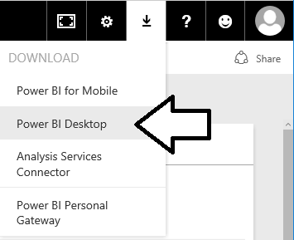
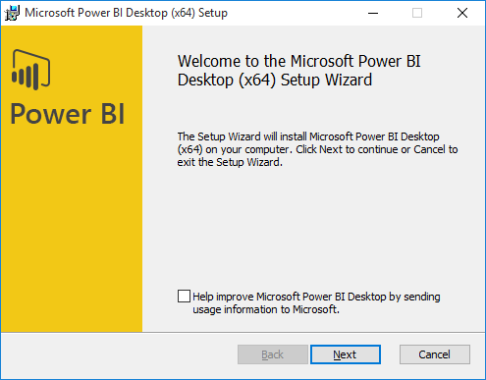
Installing Power BI Desktop
Power BI Desktop quick & easy to install over the Internet
Select Power BI Desktop option from Power BI Download menu
Power BI Desktop downloads & installs in less than a minute
Notes:
Of course, you can’t use Power BI Desktop until you installed it on a computer running Windows. Fortunately, it can be downloaded and installed in less than a minute using a standard Internet connection. Just log into the Power BI service and select the Power BI Desktop option from the Download menu to begin the download and installation process.
We recommend installing Power BI Desktop on a computer or a virtual machine running a 64-bit version of either Windows 10 or Windows Server 2016. However, it is possible to install Power BI Desktop on older 32-bit versions of Windows all the way back to Windows 7 and Windows Server 2008 R2. The main advantage of using a 64-bit version of Windows over a 32-bit version is that you can load much larger datasets into memory and you can install and test Power BI Gateways which do not support 32-bit operating systems.
Power BI Desktop is built on top of .NET Framework version 4.5 which is automatically installed with recent versions of Windows. However, older versions of Windows might require you to download and install .NET Framework version 4.5 before you will be able to install Power BI Desktop.

Slide 18

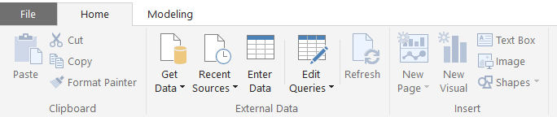
Getting Around in Power BI Desktop
What do you need to learn to use Power BI Desktop?
Query features for importing data
Design features for modeling data
Report designer for creating reports
Navigating between view modes
Report View
To access query features
Data View
Relationship View
Notes:
What do you need to learn to get up to speed on Power BI Desktop? There are three main areas to focus on at first which include creating queries, modeling data and designing reports. First, you must learn how to design queries which import data. The creation of queries is what allows you to create a base set of tables in the dataset for a Power BI Desktop project. Next, you must learn how to use the data modeling features so you can extend the project’s dataset to create a rich data model with things like calculated columns, measures and hierarchies. After that, you must learn how to use the report designer in Power BI Desktop to present the data analysis for your project using tables and visual images and to provide the user with interactive capabilities.
You will use Power BI Desktop’s main application window to model data and to design reports. The main application window provides a left navigation menu that allows you to switch back and forth between report view, data view and relationship view. When you need to create and design queries, you will do that in a separate Query Editor window which can be opened using one of the menu buttons in the ribbon of the main application window inside the External Data group on the Home tab.

Slide 19
Power BI Desktop is an ETL Tool
ETL process is essential part of any BI Project
Extract the data from wherever it lives
Transform the shape of the data for better analysis
Load the data into dataset for analysis and reporting
CSV
File
Power BI Desktop
Power BI Desktop Project (PBIX)
Dataset
Excel
Workbook
OLTP
Database
Notes:
Every custom BI solution works with some type of data. Some custom solutions require integrating data from multiple data sources into a single dataset for analysis. Early in the lifecycle of a Power BI desktop project, you must discover where the data you need lives and then you must decide how you are going to import it into a dataset that will eventually be used for data analysis and reporting. This is the project lifecycle phase that is often called the "ETL" phase because it involves extracting data, transforming data and then loading data.
Power BI Desktop is a self-service ETL tool for business users. It has the ability to extract data from a variety of data source. However, the real value of Power BI Desktop is that you can perform many types of transforms to better shape the data just before it's loaded.

Slide 20
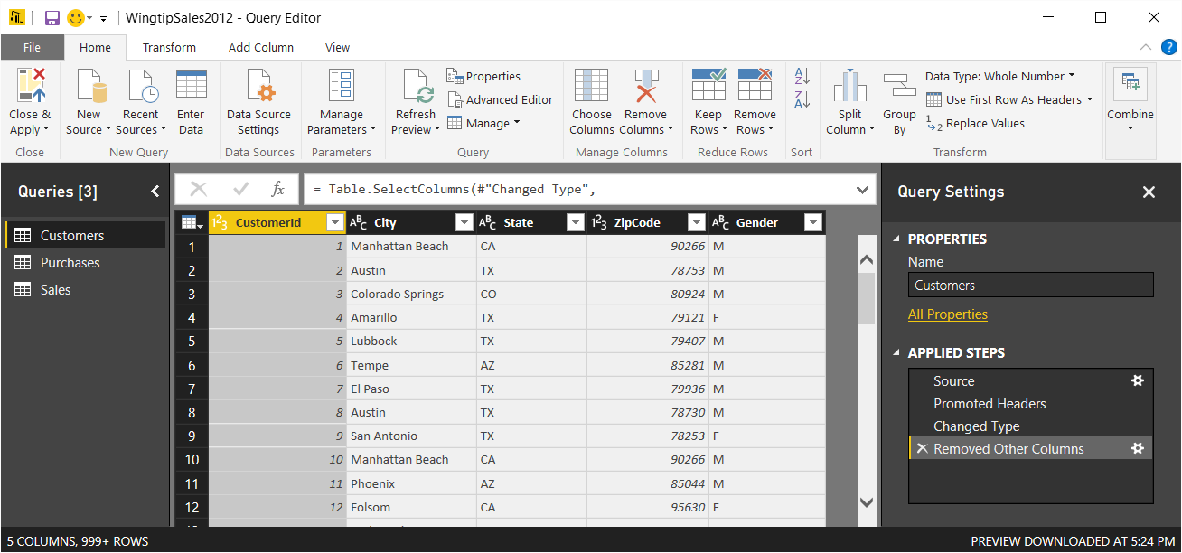
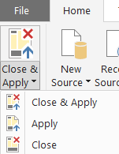
Query Editor Window
Power BI Desktop provides separate Query Editor window
Provides powerful features for designing queries
Displays list of all queries in project on the left
Displays Properties and Applied Steps for selected query on right
Preview of table generated by query output shown in the middle
Query can be executed using Apply or Close & Apply command
Notes:
In Power BI Desktop, do not design queries in the main application window. Instead, you edit queries using a separate Query Editor window. That means you must become comfortable moving back and forth between the main application window and the Query Editor window. You can open the Query Editor window using one of the menu buttons in the ribbon of the main application window inside the External Data group on the Home tab.
You design queries by executing commands on columns in the Query Editor window and working with the commands available in the ribbon. The Query Editor window displays a list of all queries in project on the left making it possible to select the query you want to work on. The Query Editor window displays the Properties section and the Applied Steps section for selected query on right. In the middle of the screen, the Query Editor window displays a preview of the table that will be generated by the query’s output.
When you are done designing queries, you often need to execute them to import data into your project to create a base set of tables. You can execute the queries you have been editing by running either the Apply command or the Close & Apply command from the Home tab in the ribbon. The difference between these commands is that the Apply command executes queries while leaving the Query Editor window open while the Close & Apply command execute the queries and then closes the Query Editor window.

Slide 21
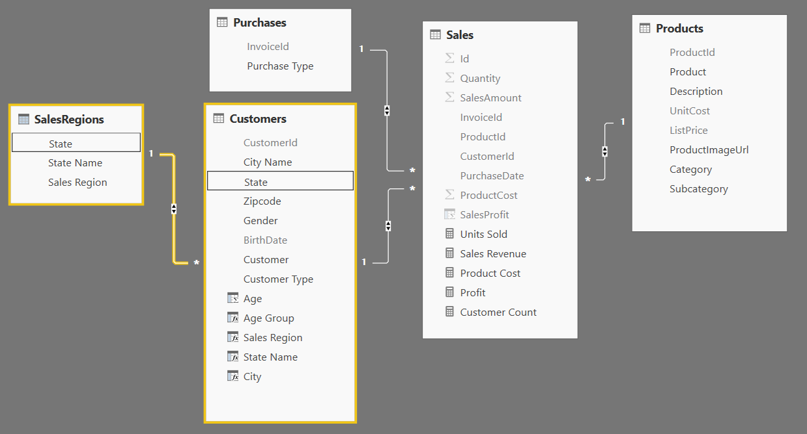
Data Modeling
xxxx

Slide 22
Working with DAX
DAX is the language used to create data models
DAX stands for "Data Analysis Expression Language"
DAX expressions are similar to Excel formulas
They always start with an equal sign (=)
DAX provides many built-in functions similar to Excel
DAX Expressions are unlike Excel formulas…
DAX expressions cannot reference cells (e.g. A1 or C4)
Instead DAX expressions reference columns and tables
=SUM('Sales'[SalesAmount])

Slide 23
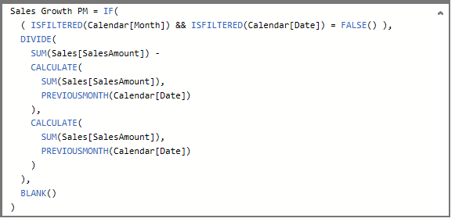
Writing DAX Expressions
Some DAX expressions are simple
Some DAX expressions are far more complex

Slide 24
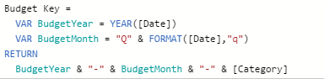
Creating Variables in DAX Expressions
Variables can be added at start of expression
Use VAR keyword once for each variable
Use RETURN keyword to return expression value

Slide 25
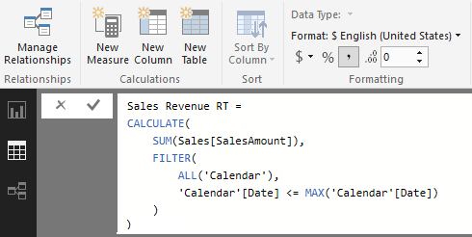
Creating Running Total using CALCULATE
Calculate a running total of sales revenue across years
This must be done using CALCULATE function

Slide 26
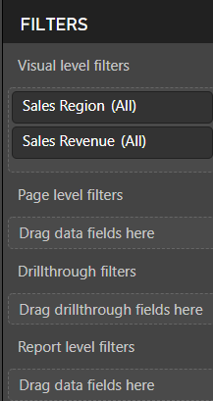
Creating Reports
Power BI Desktop project contains one report
Report within project can contain multiple pages
Report pages contains visuals
Reports can be created using filters
You can add visual level filters
You can add page level filters
You can add drillthrough filters
You can add report level filters

Slide 27
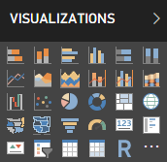
Built-in Visualization Types
Table and Matrix
Bar charts and Column charts
Pie charts and Doughnut chart
Line chart and Area chart
Scatter chart and Combo charts
Card and Multi-row Card
Treemap
Ribbon chart
Waterfall chart
Funnel chart
Gauge
Map and Filled Map
Slicer
R script visual
Shape map (in preview)

Slide 28
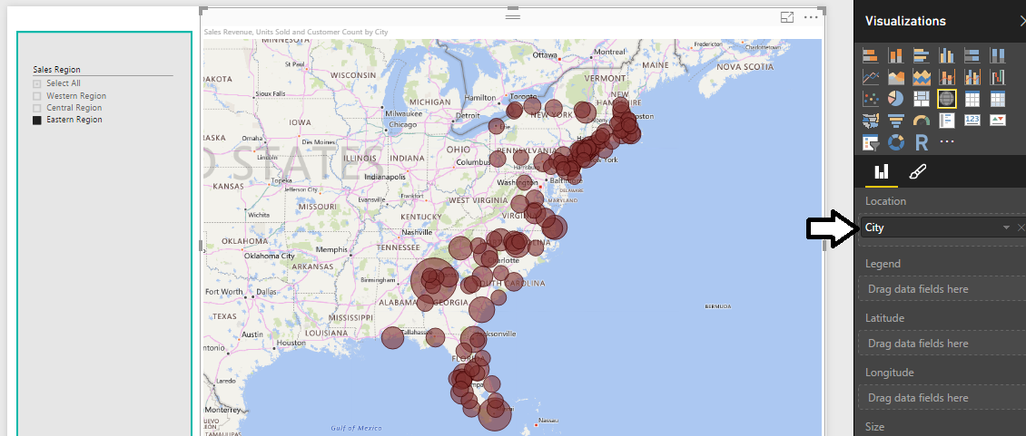
Using Map Visual with a Geographic Field
Map Visual shows distribution over geographic area
Visual automatically updates when filtered

Slide 29
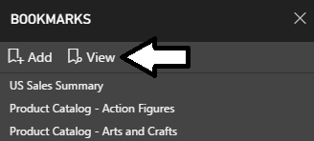
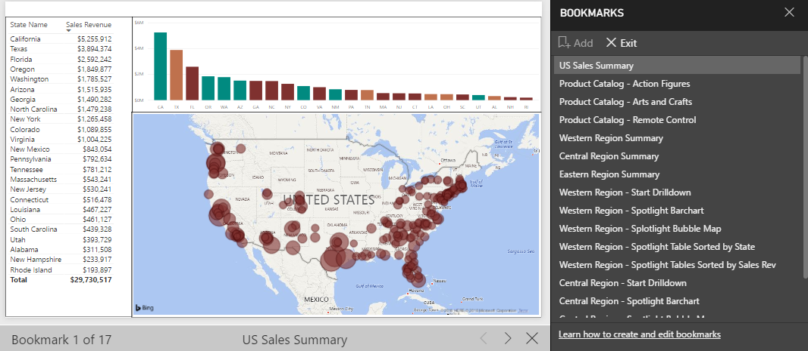
Bookmarks as a Slide Show
Bookmarks can be viewed as slide show
Start slide show by clicking View button
Consumer can step through one bookmark at a time

Slide 30
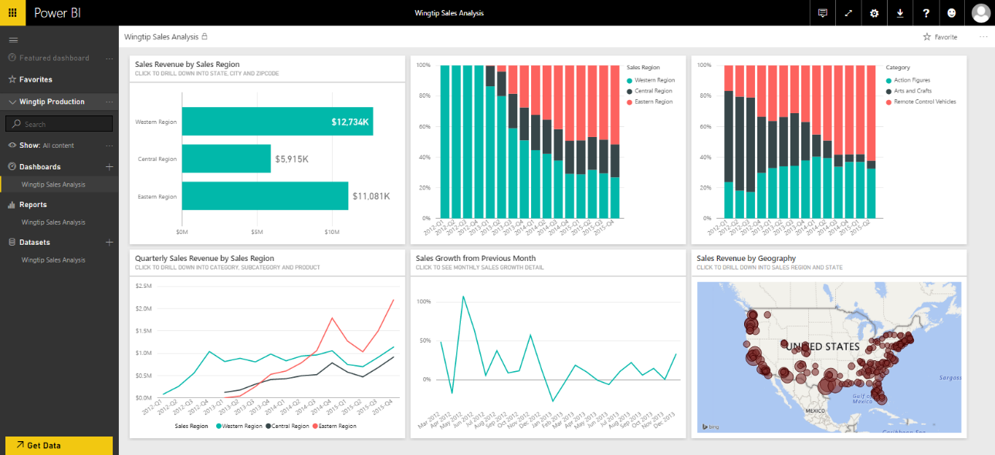
Dashboards in Power BI
Dashboard is consolidated view of reports & datasets
Provides simpler, more intuitive entry point to reports and datasets
Simplicity and intuition key for users with mobile devices & tablets
Dashboard represents unit of deployment and reuse
Dashboards can by deployed via dashboard sharing
Dashboards can by deployed using organizational content packs

Slide 31
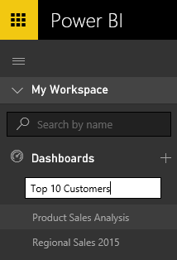
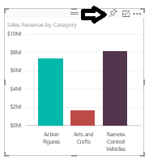
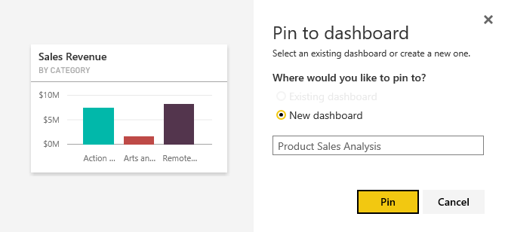
Creating Dashboards
Dashboard is a collection of tiles
Dashboard tiles can be created by pinning a visual from a report
Dashboard tiles can be created from Q&A search result
Each tile is snapshot of information from an underlying dataset
Dashboard can be created two different ways
Click on (+) button in Dashboards section of navigation pane
Create new dashboard when pinning visual from report

Slide 32
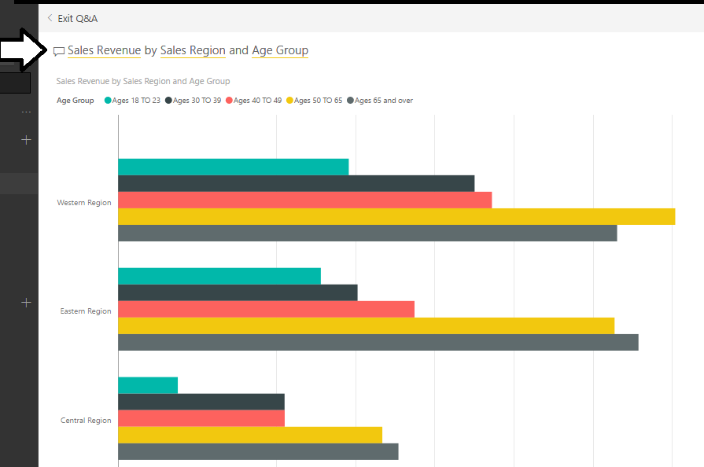
The Q&A Search Box
Used to execute natural language queries
Queries are executed against underlying dataset(s) in workspace
Query results display using some type of Power BI visual
Power BI service selects Visualization type based on result type

Slide 33
Power BI Apps and App Workspaces

Slide 34
Agenda
Introduction to the Power platform
Power BI
PowerApps
Flow
Power platform Integration
Building a Trial Environment

Slide 35
PowerApps Landscape
Canvas Apps
Works with any data source
Model-drive apps
Built on top of CDS for Apps

Slide 36
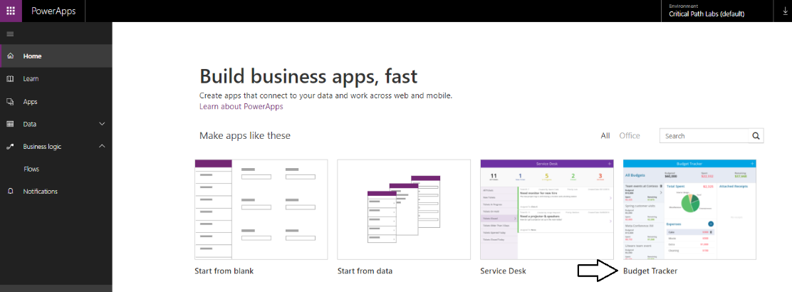
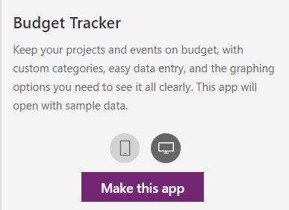
Creating New Apps
You create new apps from the PowerApps Home page
Located at https://web.powerapps.com
Chose an app template
Choose between Mobile App and Tablet|Desktop App
Click the Make this app button
New app creation redirects you to PowerApps Studio
Located at https://create.powerapps.com
Notes:
When you start using PowerApps, there are two important URLs that are easy to confuse with one another. The first is the URL to the PowerApps Home page which is located at https://web.powerapps.com. The second is the URL to PowerApps Studio which is https://create.powerapps.com. It’s important you understand the difference between these two locations.
You should navigate to the PowerApps Home page at https://web.powerapps.com whenever you would like to create a new app or when you would like to play, edit or share an app you have already created. There is a navigation menu on the left which allows you to see and manage other PowerApps resources such as connections, custom connectors and custom entities in the Common Data Service for Apps.
Whenever you create a new app or you edit an existing app, you will be redirected to PowerApps Studio at https://create.powerapps.com. In other words, PowerApps Studio is the place where you do all your work designing, testing and debugging the apps you create with PowerApps. When you navigate to PowerApps Studio, you will notice that the browser resolves to a URL that has a locale inside it as in the case of https://us.create.powerapps.com.

Slide 37
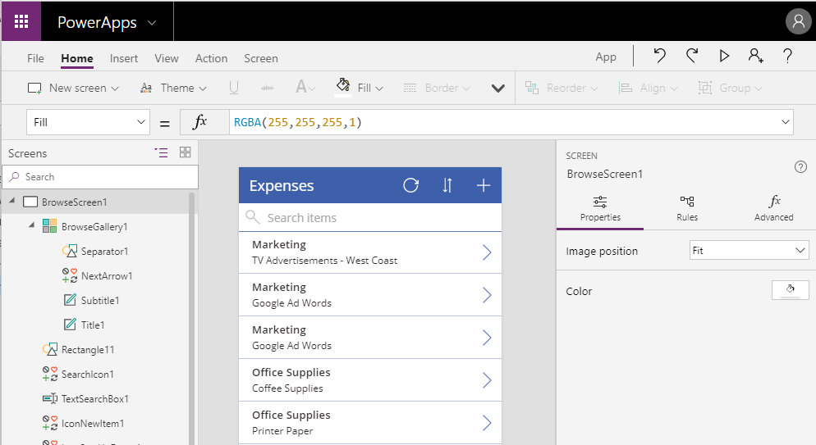
Getting Started with PowerApps Studio
PowerApps Studio for the Web is used to build apps
Environment supported across platforms (Windows & Mac)
Supports all popular, modern browsers
Notes:
If this is your first day using PowerApps, it will take a small bit of time to become accustomed to PowerApps Studio. In the first hands-on lab, you will get experience creating and building new apps. Once you create a new app, you must learn how to move from screen to screen and how to add new controls. You must also learn to set property values using the Properties pan and by writing formulas in the Formula bar.
PowerApps Studio provides a user interface using the following components
Left navigation menu displays app hierarchy of screens and controls.
Screen designer is the pane in the middle showing the current screen in design mode.
Right-hand pane displays Properties pane, Rules pane and Advanced pane.
Property dropdown list allows you to select property for Formula bar.
Formula bar where you write formulas in PowerApps Formula Language.
Ribbon tabs provide ribbon buttons to add and customize design elements.
PowerApps Studio is primarily available as a web-based application that is accessible through any modern browser. You should note that there is also a native version of PowerApps Studio that can be installed on the Windows operating system or on a Mac. These native versions of PowerApps Studio were more important in the early preview days of PowerApps because back then they provided functionality that was not available in the web-based version. At this point, Microsoft has improved the web-based version so it now includes all functionality that exists in the native application versions. Furthermore, Microsoft now recommends using the web-based version of PowerApps Studio over the native versions because that’s where Microsoft’s primary investments will be made moving forward.

Slide 38
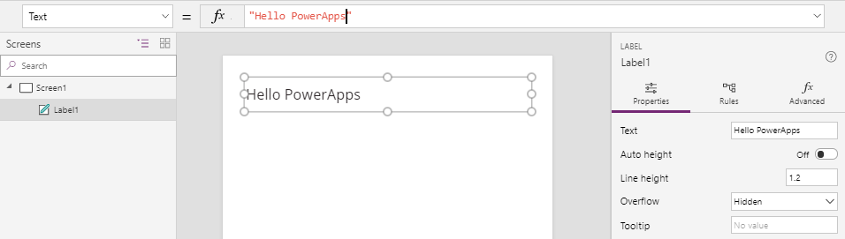
Configuring Control Properties
Control properties can be set two different ways
Property values can be set using Properties pane
Property values can be set using Formula bar
Building apps with PowerApps requires shift in thinking
You don’t write code to set property values like in VBA
Control properties configured using formulas
You develop using declarative style instead of procedural style
Notes:
When it comes to configuring the property values for a control, you have two choices. First, you can configure property values using the Properties pane on the right. In the example shown on the slide above, you can see that the Properties pane displays an editable textbox for the Text property of a Label control. This textbox in the Properties pane makes it possible to view and update the Text property of the label.
As an alternative to using the Properties pane, you can edit the Text property of a control using the Formula bar which is located above the PowerApps screen designer. To edit a control property using the Formula bar, you must first select the control. Next, you must select the property you want to configure in the property selector dropdown menu to the left of the Formula bar. After that, you can configure the control property by writing a formula in the Formula bar. In the example shown on the slide above, the formula in the Formula bar sets the Text property of the Label control. While the formula used in this example is just a static string value, you can write formulas which are dynamic. The ability to write dynamic formulas for screen and control properties adds a very important aspect to the PowerApps development model.
Let’s take a step back and think about how PowerApps allows you to set control properties using dynamic formulas. This leads to a development style that is quite different than times in the past when you may have written code in a programming language such as VBA, VB or C#. In these other languages, it is common to write procedural code that sets control properties. For example, you might write code behind the Reset button on a form to set the Text property of every textbox back to an empty string. This style of procedural coding is not the same style of development that you should be using when you begin working with PowerApps.
In PowerApps, you will not be writing any procedural code to set control properties. Instead, you configure control properties by writing formulas. Therefore, control properties take care of setting their own values. This leads to a development style in PowerApps that is ‘declarative’ instead of ‘procedural’. However, in order to master this new declarative style of development, you must first learn about the syntax of the PowerApps Formula Language.

Slide 39

PowerApps Formula Language
PowerApps provides its own Formula Language
Designed to be as similar as possible to Excel Formula language
PowerApps Formula Language includes built-in set of functions
You write formulas for specific properties
Set the Text property for a label
Set the Color property of the label text
Write an formula to filter the items shown in a gallery
Notes:
PowerApps defines its own Formula language for writing the formulas used to configure control properties. When Microsoft created the PowerApps Formula language, they tried to make it as similar as possible to the Excel Formula language. The reason for this is that are already 100 trillion (OK, maybe that’s an exaggeration) business users that know how to write formulas in an Excel workbook. Many Excel users will feel at home as they begin to write formulas in PowerApps because it uses a syntax and functions that they are already familiar with.
The PowerApps Formula language includes a built-in set of functions. Here are a few simple examples. You can use the Text function to apply formatting to a currency value. You can use the User function to return an object with information about the current user. You can use the Filter function to filter the set of records displayed in a Gallery control.
In the next module, you will see that PowerApps Formula language provides additional syntax for compound data structures such as tables and records. You will also learn that some functions provided by the PowerApps Formula language return a value while other perform an action. If you want to take a look at Microsoft documentation for this language, you can navigate to the following URL:
https://docs.microsoft.com/en-us/powerapps/maker/canvas-apps/formula-reference

Slide 40
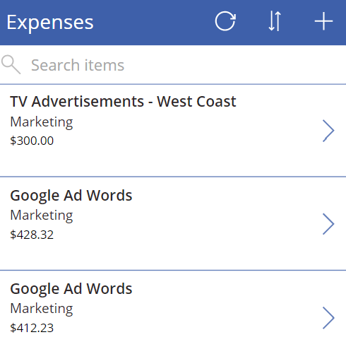
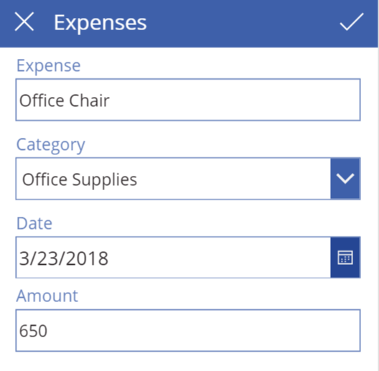
Data Binding with Galleries and Forms
Table binding
Gallery control
DataTable control
Single-record binding
Display form control
Edit form control
Notes:
Data binding is one of the key features in PowerApps that dramatically simplifies the process of building an app to access data. When you create a new app using the ‘Start from data’ template, PowerApps Studio will use data binding when it generates the connection, the screens and the controls for the app. This means you can use data binding without really understanding how it works. However, learning how data binding really works in PowerApps will help you become a better app builder.
Data binding in PowerApps is based tabular data which is laid out in terms of tables and records. Some controls support data binding to a table of records while other controls support binding to a single record at a time. The Gallery control and the DataTable control are examples of controls that can be bound to a table of records. For example, you can create a Gallery control to display a set of expenses.
Forms are a special type of control that support data binding with a single record of data at a time. You can use a Display Form control when you want to display a single record of data in a read-only fashion. You can use an Edit Form control when you want to build a screen that allows a user to add a new record or to edit an existing record.

Slide 41
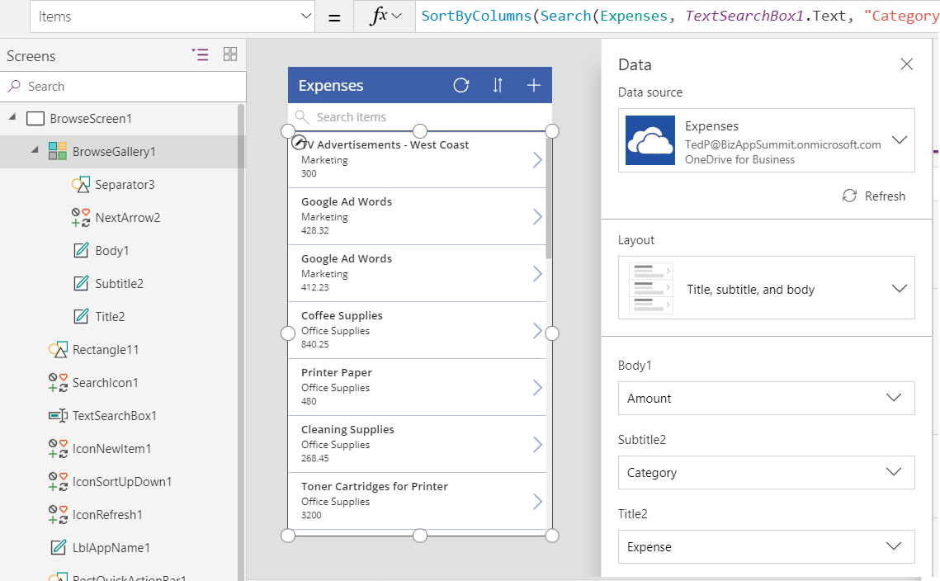
Working with the Data Pane
You use the Data pane to configure data binding
Select a data-bound control and then display Data pane
Data pane allows you to change layout for data binding
Once you select layout, you can then map fields below
Data-bound control
Data-bound connection
Data-binding layout
Field mappings
Notes:
In order to customize the way data binding works, you must learn to use the Data Pane in PowerApps Studio. You use the Data Pane when you need to configure or customize the data binding for a data bound control such as the Gallery control. In order to use the Data pane, you must first select the data-bound control in the left navigation and then you can open the Data pane by navigating to the View tab in the ribbon and clicking the Data sources button. When a Gallery control is selected, the Data pane shows the details of the data binding including the connection, the data binding layout and the field mappings. It’s easy to switch back and forth between different layouts and to update the field mappings to creating a better view of the underling data.
There is a common design pattern used in PowerApps where an app is created with three screens including (1) a browser screen, (2) a detail screen and (3) an edit screen. All three screens are used to data bind to the same underlying table. The browser screen contains a Gallery control with data binding to display many records at once. The detail screen uses a Display Form control to display the data for a single record in a read-only fashion. The edit screen contains an Edit Form control which allows users of the app to add new records and edit existing records.

Slide 42
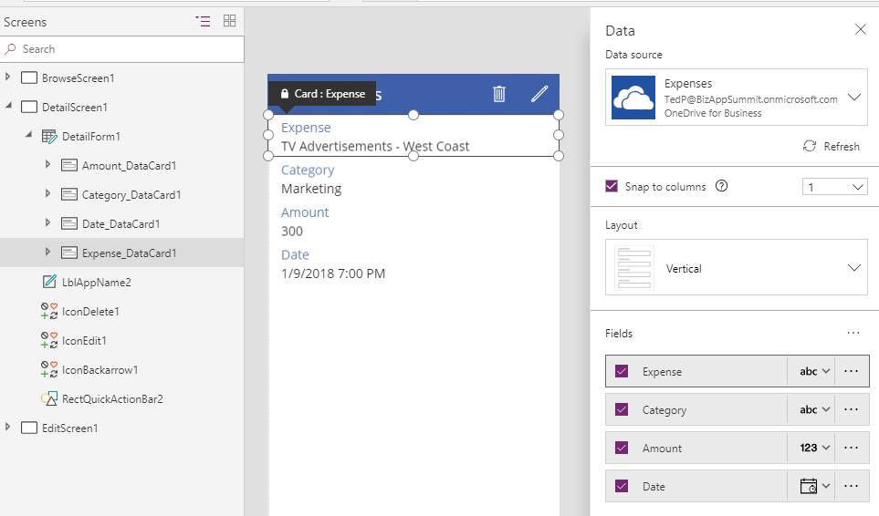
Understanding Forms and Data Cards
Form acts as a container for data cards
Each form binds to a single record
Within a form, each data card binds to an underlying field
Each data card contains an encapsulated set of child controls
Notes:
In PowerApps, you use display forms and edit forms for scenarios where you need to bind to a single record at a time. Display forms and edit forms act as containers that hold another type of control known as a 'data card’ which is also called a 'card control'. Each form contains a set of data cards that bind to individual fields from the underlying record. Each data card has a DataField property that determines which field it binds to within the underlying record.
A data card contains its own set of child controls. The child controls inside a data card make up the experience for displaying and editing a single field. For example, a number data card may consist of a Label control to provide the display name of the field and a Text input control to provide an editor for the value of the field. Most of the data cards supplied by PowerApps also provide a label control to display any validation errors that occur due to bad user input.
When you are writing a formula for a Form control property and a data card propertythe current record is available using an object named ThisItem. The ThisItem object for a Form control contains properties for each field in the underlying record.
When you are writing a formula for the properties of a child control inside of a data card, you can use the Parent object. For example, a child control inside a data card should use Parent.Default to read the initial state of the field from the data source. By using Parent instead of directly accessing the information that you want, the data card is better encapsulated. That means you can use the same data card with multiple fields in the same record without breaking internal formulas.

Slide 43
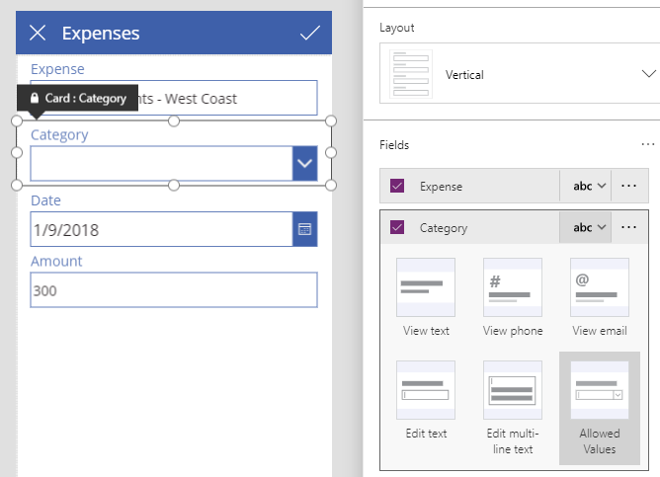
Changing a Field’s Data Card Type
Fields in Form control get default data card
Use Data pane to change data card used by any field
Different data cards offer different editing experiences
Notes:
PowerApps provides several different types of data cards which can be used with various data types to create customized user interface experiences. When you use the ‘Start from data’ template to create a new app, PowerApps automatically generates a new view form and a new edit form for you with a default set of data cards.
Sometimes PowerApps will create a default set of data cards that isn’t exactly what you want. However, you can swap out the default data card used for a field with a different type of data card that improves the user experience. For example, imagine you have an Expenses table with a Category field which only allows 4 predefined category values. You can change the default data card which uses a standard textbox to a different data card that supplies the user with a dropdown list of choices.
Working with data cards can be a little tricky at first because you must select the form in the left navigation and then display the Data pane. Once you’ve done that, you can then view and edit the type of data card used for each field. The slide above shows an example of changing from a data card with a textbox over to a better data card named ‘Allowed Values’ that provides a dropdown menu.

Slide 44
Agenda
Introduction to the Power platform
Power BI
PowerApps
Flow
Power platform Integration
Building a Trial Environment

Slide 45
What is Flow?
Service for automating workflows across other services
Designed by Microsoft for business users more than developers
What can you do with Flow?
Get notifications
Copy files
Collect data
Automate approvals

Slide 46
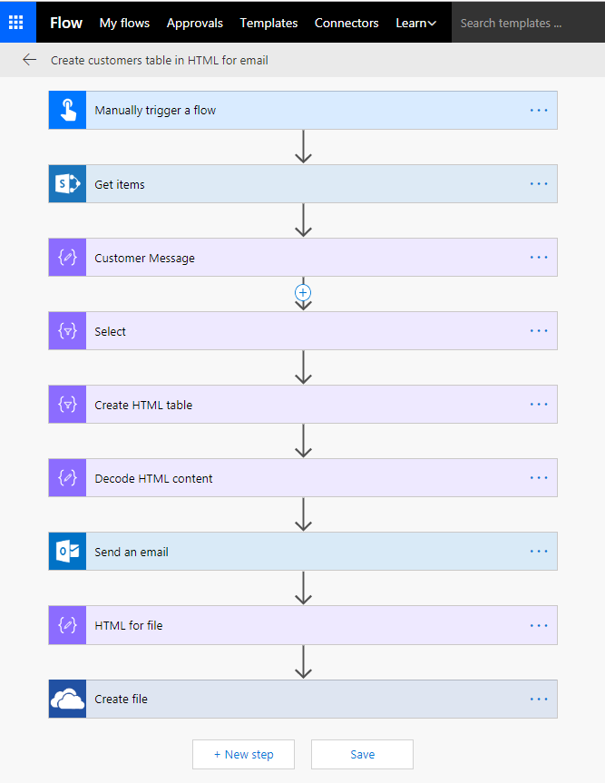
Building Blocks of Flow
Triggers - events that start a flow
Actions - tasks and operation executed by flow
Services - sources and destinations for data
Connectors - wrappers to communicate with service APIs
Custom Web API
SharePoint List
HTTP
Connector
SharePoint
Connector

Slide 47






Flow Trigger Types
Scheduled Flow Triggers
Runs periodically based on an interval
Automated Flow Triggers
Runs when something happens
On-demand Flow Triggers
Runs when a user clicks a button

Slide 48
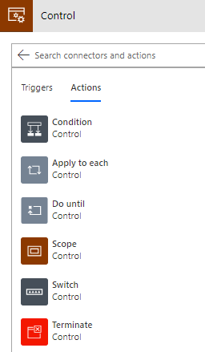
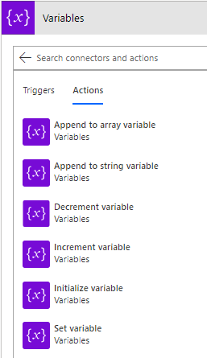
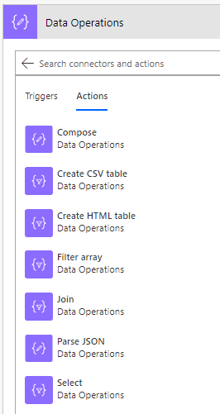
Core Action Categories
Control: actions to provide control-of-flow
Variables: actions to manage state within flow lifetime
Data operations: action to process data & prepare content

Slide 49
Agenda
Introduction to the Power platform
Power BI
PowerApps
Flow
Power platform Integration
Building a Trial Environment

Slide 50
PowerApps Integration with Power BI
PowerApps visual
Add action after insight
Enable writeback in power bi reports and dashboard

Slide 51
Flow Integration with PowerApps
PowerApps buttons
PowerApps can call flow and pass data back and forth
PowerApps response

Slide 52
Flow Integration into Power BI
Real-time dashboard

Slide 53
Power platform integration with Office 365

Slide 54
Power platform Integration with Dynamics 365

Slide 55
Common Data Service for App

Slide 59
Agenda
Introduction to the Power platform
Power BI
PowerApps
Flow
Power platform Integration
Building a Trial Environment

Slide 60
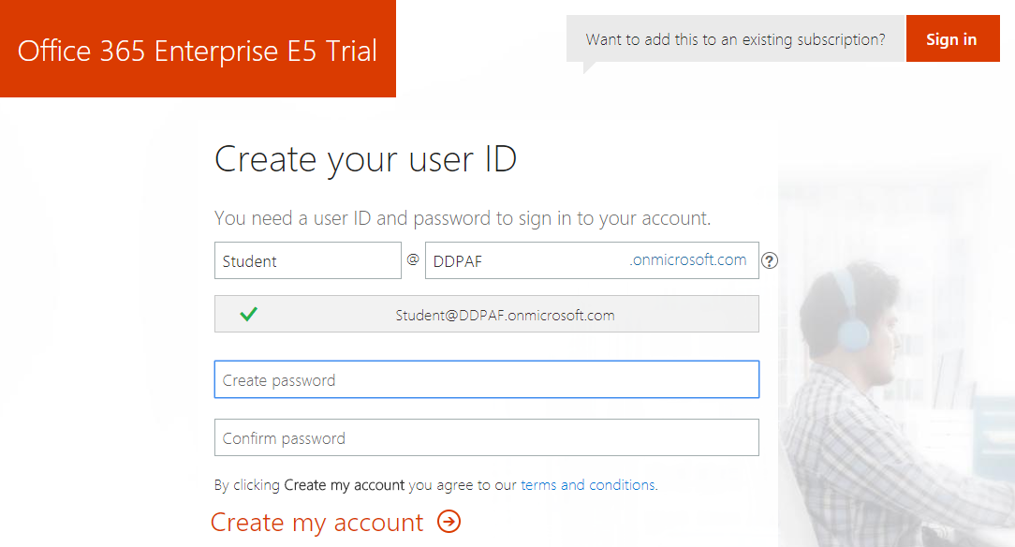
Creating an Office 365 E5 Trial Tenant
All students will create an Office 365 trial tenant
Provides an isolated development environment for lab exercises
Trial accounts will last for 30 days
Notes:
In the lab exercises for this course, you will go through the steps to sign up for an Office 365 Enterprise E5 trial account. By doing this you will create a new Office 365 tenant which makes it possible to create multiple user accounts. A key point here is that you are creating a trial account for an entire Office 365 organization as opposed to creating a trial account for a single user.
When you initially create the new Office 365 tenant, you will be prompted to enter the user name and password for a new user account. This initial user account will be created with full tenant administrator capabilities. This means that this accounts with have full administrative control over user management and group management within the Office 365 tenant. This account will also be able to see and modify the organization-wide administrative settings for important cloud services such as Azure AD, SharePoint Online, Power BI and, of course, PowerApps and Microsoft Flow.
A significant benefit of creating a test environment in this fashion is that you can create additional users which makes it possible to test PowerApps and Flow scenarios such creating custom connectors and configuring an On-Premises Gateway. An Office 365 Enterprise E5 trial account allows you to add up to 25 user accounts for testing purposes. You will also be able to create new PowerApps environments so you can create a setup where you build apps and other components in a development/staging environment and then practice how to package and deploy your work to a production environment.

Slide 61
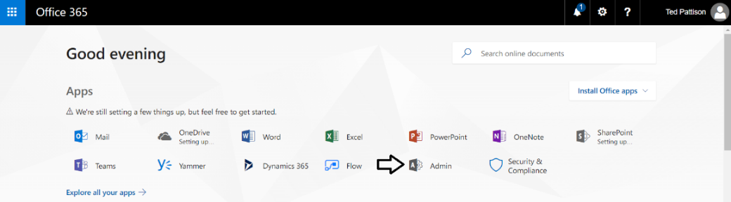
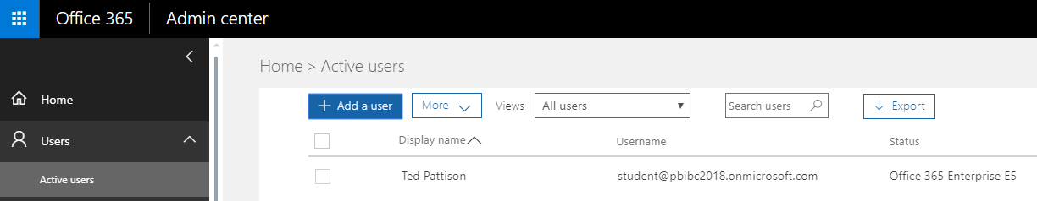
Office 365 Admin Center
Navigate to the Office 365 Admin center
Allows for management of users accounts and licensing
Notes:
Once you have created your new Office 365 Enterprise E5 trial account, you should become familiar with the process of navigating around inside the Office 365 Admin center. For example, you need to learn how to add new user accounts and groups. In the lab exercises, you will add a secondary user account for testing purposes. For most of the class, you will log in and complete your work using your primary user account which will have tenant-level administrative permissions. The benefit of creating a second user account is that you can log in and test your apps and flows with a typical user account which does not have any administrative permissions.
The Office 365 Admin Center also allows you to purchase new subscriptions and to start trial subscriptions. This is something you will be required to do. More on that as we move to the next slide.

Slide 62
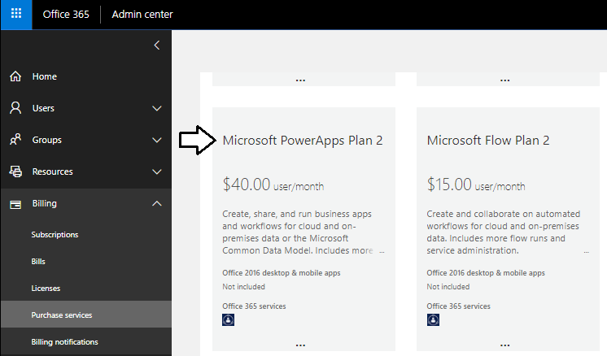
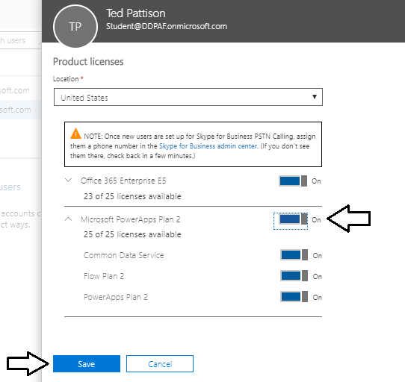
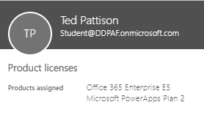
Configuring a PowerApps Plan 2 License
Certain design tasks require PowerApps Plan 2
You can start a 30-day trial for PowerApps Plan 2
License must be assigned to individual user accounts
Notes:
In the lab exercises for this module, there are instructions to configure your primary Office 365 user account with a PowerApps plan 2 license. The reason for this is that it provides you with the ability to view and create PowerApps environments and to work with the Common Data Service for Apps to complete design tasks such as creating a custom entity or a model-driven app.
Here are the high-level steps required to configure a PowerApps Plan 2 license.
Navigate to the Purchase services ion of the Office 365 admin center
Start a Trial Subscription of Microsoft PowerApps Plan 2
Configure Your User Account with a Microsoft PowerApps Plan 2 license
Note that the upcoming lab exercises for this module will provide you with the step-by-step instructions needed to complete these steps.

Slide 63
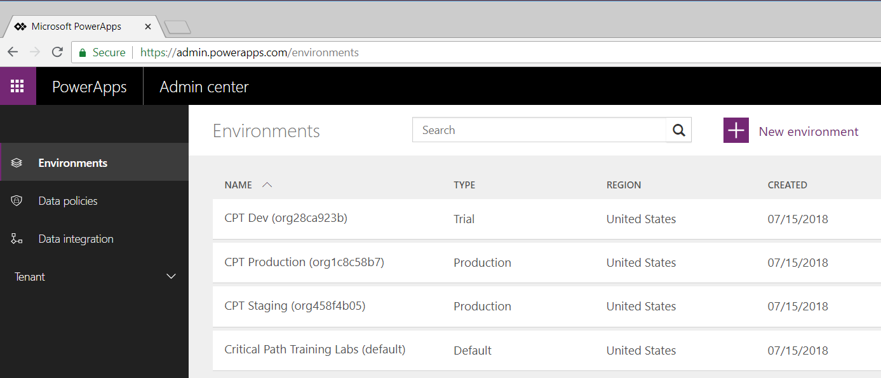
PowerApps Admin Center & Environments
PowerApps architecture based on environments
Environment provides context for creating apps and flows
Every tenant is automatically created with default environment
Organization can create multiple environments for dev & staging
PowerApps Plan 2 license required to manage environments
Notes:
The architecture for PowerApps and Flow is based on an important concept of “environments”. Any time you create a new app with PowerApps or a new flow, you are always doing so within the context of a specific environment.
You don’t have to think about environments when you start working with PowerApps. That’s because every new Office 365 tenant is automatically created with default environment. When you first begin to create apps and flows, you will be working within the default environment for the tenant that was created along with your new Office 365 trial account. During the first part of this training course, everything you do will be done in the default environment.
You can view and manage the environments for the current Office 365 tenant by navigating to the PowerApps Admin center at https://admin.powerapps.com. Note that you will not be able to view existing environments or create new environments until your Office 365 user account has been assigned a PowerApps Plan 2 license.
This training course provides a module on application lifecycle management (ALM) with PowerApps and Flow. At that point, the instructor will go into greater detail about creating and managing environments. As you will learn, an organization can benefit from creating multiple environments to assist with developing and staging the apps and flows they build. After building and testing apps and flows in a staging environment, an organization can design a strategy for packaging and deploying them into a production environment.

Slide 64
Summary
Introduction to the Power platform
Power BI
PowerApps
Flow
Power platform Integration
Building a Trial Environment

Slide 65
Summary
Getting Started with PowerApps
Creating and Testing Apps with PowerApps Studio
Working with Screens and Controls
Understanding Connectors and Data Binding
Customizing Forms and Data Cards

Slide 66

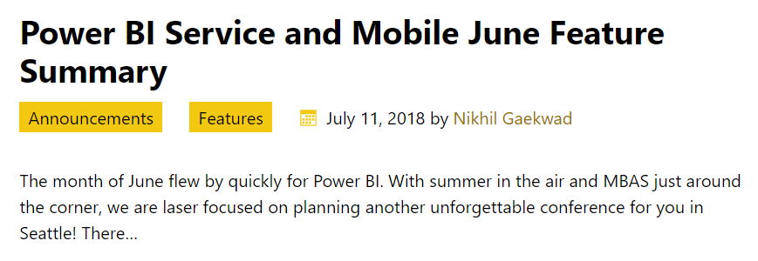
Power BI Team Blog
Power BI Team Blog is an Essential Resource
Be on the lookout for monthly updates
Notes:
Microsoft typically applies monthly updates to the Power BI platform in the last week of each month. Microsoft has been consistent at synchronizing updates to Power BI service along with its updates to Power BI Desktop. That means that the tools are staying in sync with the underlying platform. Microsoft has also been very good about complimenting their monthly platform updates with a blog post which details which features have been added or updated.
The Power BI Team Blog is an essential resource for any professional working with the Power BI platform. This blog is accessible through the URL at https://powerbi.microsoft.com/en-us/blog. Anyone that wants to claim expertise with the Power BI platform should be proactive about reading the blog post for monthly updates as soon as it is posted.

Slide 67
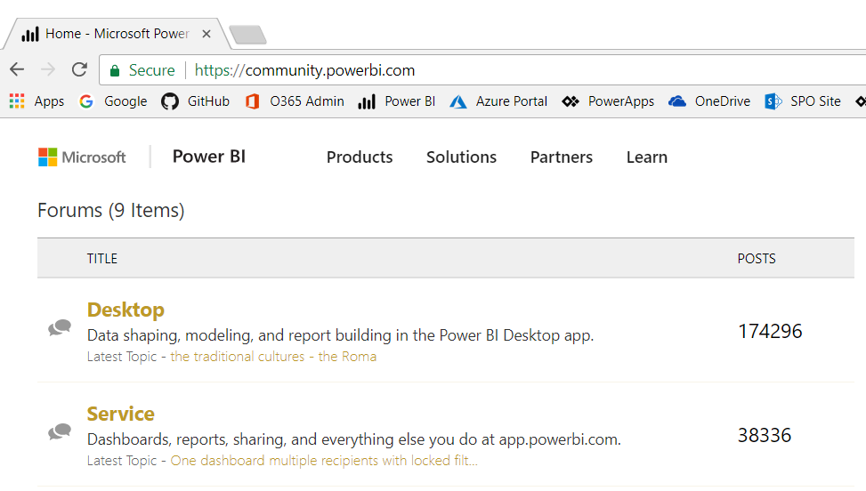
Power BI Community Forums
Located at https://community.powerbi.com/
Great place to get answers to tough questions
Notes:
Microsoft maintains a very active set of technical forums focusing on Power BI at https://community.powerbi.com/. This is a great place to post tough questions and get quality answers from Microsoft Product Team members and Microsoft MVPs. It is worth your while to create an account in this community and explore the resources that are available.

Slide 68
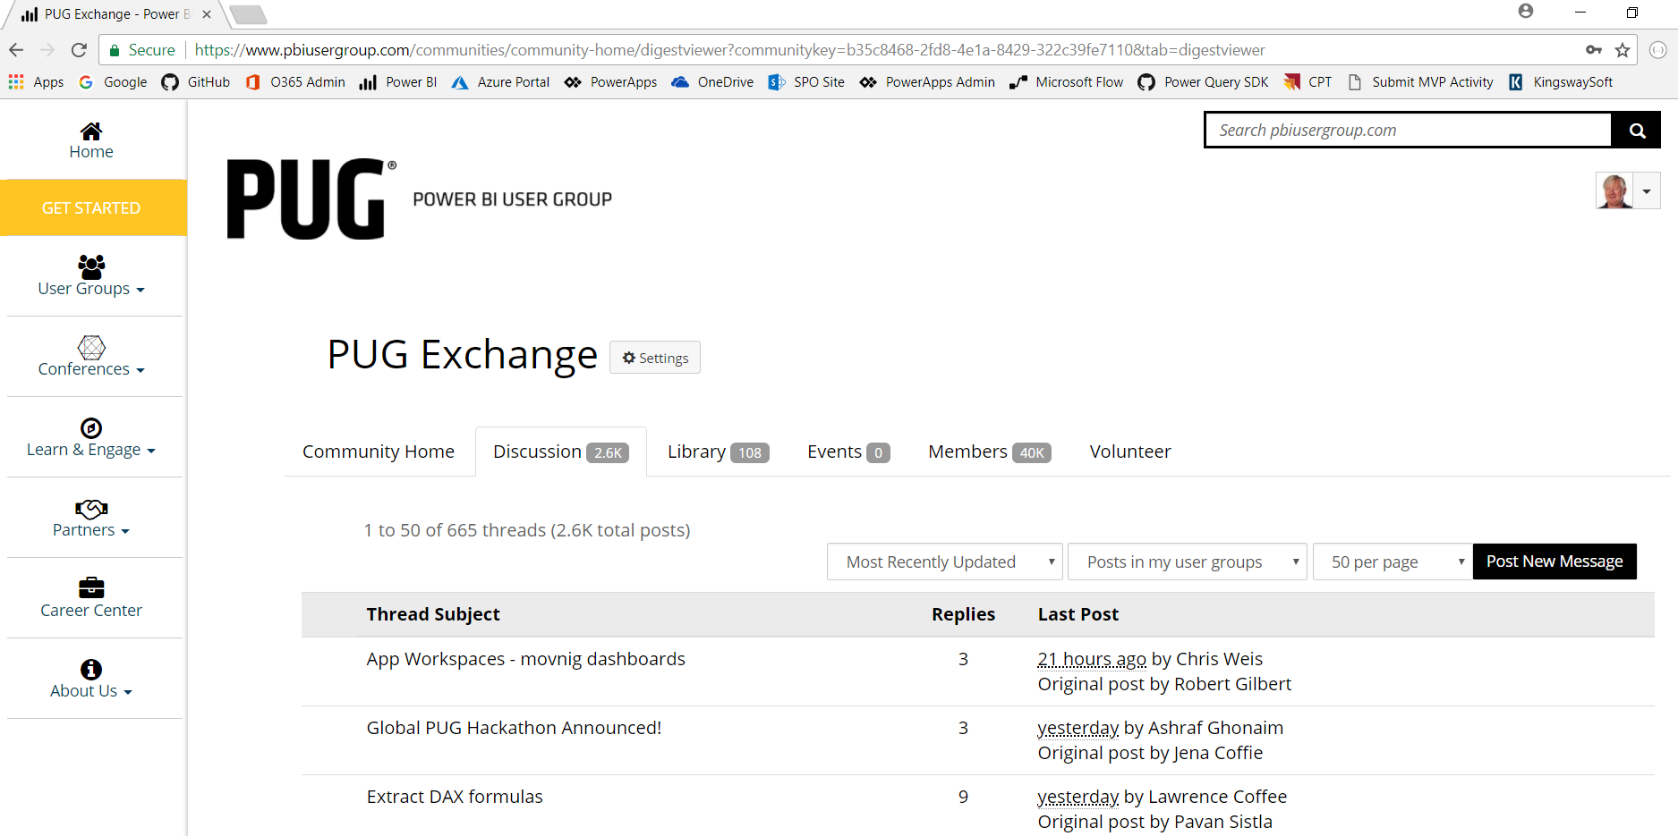
Power BI User Group (PUG)
Located at http://pbiusergroup.com/
PUG Exchange is another place to get questions answered
Also let's you find and connect with local Power BI User Groups
Notes:
The Power BI User group maintains a world-wide community site at http://pbiusergroup.com/. You can use this site to find or start up a local Power BI user group. There is also a valuable set of technical forum where you can get answers to questions especially those that involve Power BI integration with financial software such as Dynamics 365, Microsoft CRM, Navision, Axapta, Great Plains and Solomon.

